Slide 1
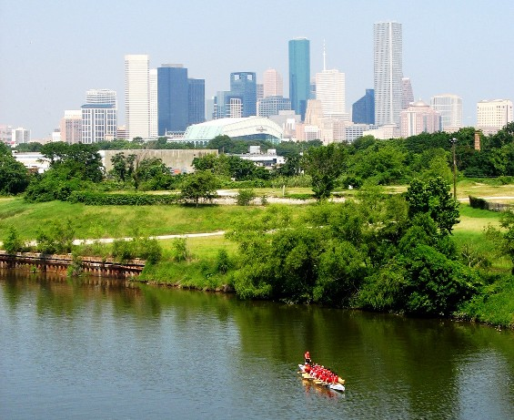
Brownfield Redevelopment
City of Houston
September 20, 2012

Slide 2
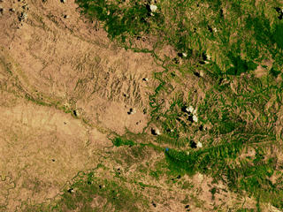
Brownfield Redevelopment
Do Policies and Program Work?

Slide 3


Brownfield Redevelopment
Science
  Remediate
    Renew
      Redevelop
        Reinvest
          Recreate
          Art

Slide 4
Brownfield Redevelopment
What is a Brownfield
“…..real property, the expansion, redevelopment, or
reuse of which may be complicated by the presence
or potential presence of a hazardous substance, pollutant or contamination.” (US EPA)

Slide 5

Brownfield Redevelopment
EPA Provides the Guidance, but it is the Community that Identifies a Brownfield
Abandoned property
Active but Underutilized
Real estate turnover complicated by real or perceived contamination
Property use Blighted –significantly conflicts with a master plan

Slide 6
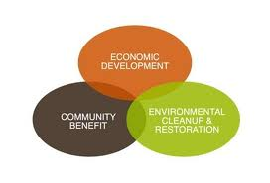
Brownfield Redevelopment
The Why?
Increase (RENEWS) property value and local tax base
Reduce the need to develop greenfields
Uses existing infrastructure (cost savings)
Mitigates public health and safety concerns
Improves the community image

Slide 7
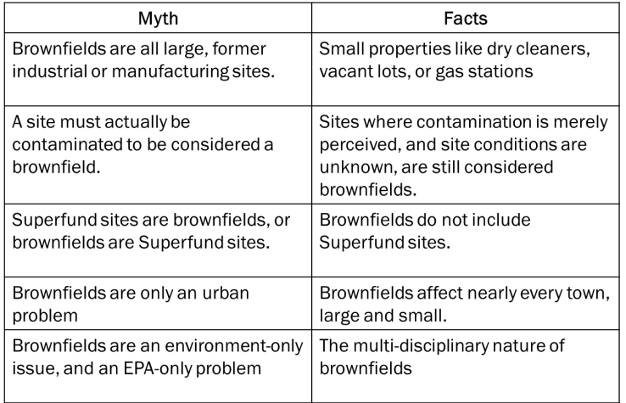

Brownfield Redevelopment

Slide 8


Brownfield Redevelopment
The City’s Brownfield Program
Public Works and Engineering Department
  Developer Services Section
    Program Manager
    Jedediah Greenfield
    Quality Assurance Manager
    Ann Sheridan, P.E.
  Both Private and Public Properties

Slide 9
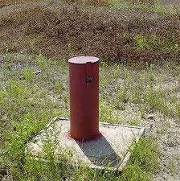
Brownfield Redevelopment
The City’s Brownfield Program
Environmental Site Assessments (Federal Funds)
Guidance to applicants during participation in State Cleanup programs
Assistance in coordination of site-related issues between intergovernmental agencies
Help with site promotion to attract a developer

Slide 10

Brownfield Redevelopment
Our Approach
Assist all possible (within legal restraints) redevelopment of Brownfield properties
Review the Community’s and City’s Plan for Targeted Areas… What’s the Big Picture?
Identify Suspected Areas
Identify Stakeholders and work with the community

Slide 11
Brownfield Redevelopment
It Takes Vision!
Evaluate potential reuse
Develop strategies
Investigate financial programs
LEVERAGE
LEVERAGE
LEVERAGE

Slide 12
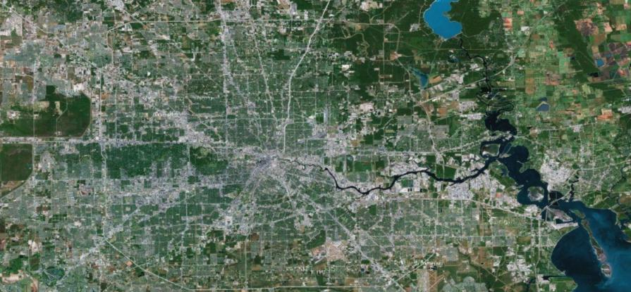
Brownfield Redevelopment
        City of Houston

Slide 13
Brownfield Redevelopment
Approach
Big Development to Bring Growth
Hardy Yards Mixed Use
  Former Rail Yard
  Just North of DT
  Transit Center
    Incentives
    Assessment
    Clean up
    TIRZ

Slide 14
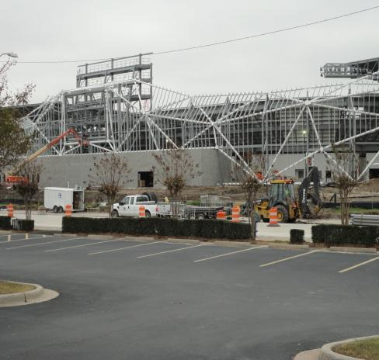
Brownfield Redevelopment
Approach
Big Development to Bring Growth
Dynamo Stadium
  Former Industrial
  Just East of DT
    Incentives
    Assessment
    Clean up
    TIRZ

Slide 15
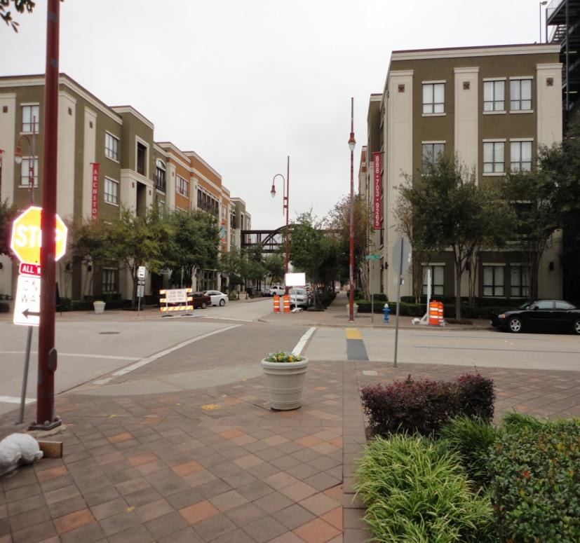
Brownfield Redevelopment
Approach
Big Development to Bring Growth
Mixed Use
  Incentives
    TIRZ
    DPC
    Tax Credit

Slide 16

Examples within The City of Houston’s Portfolio of Successful Brownfield Redevelopment Projects
Brownfield Redevelopment

Slide 17
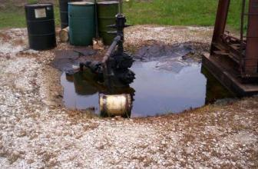
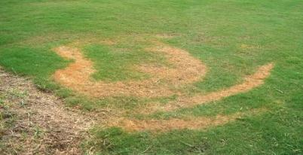
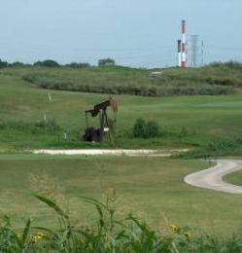
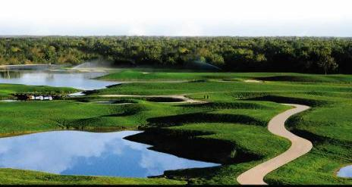
Brownfield Redevelopment
Wildcat Golf Club – 1200 Almeda Road

Slide 18
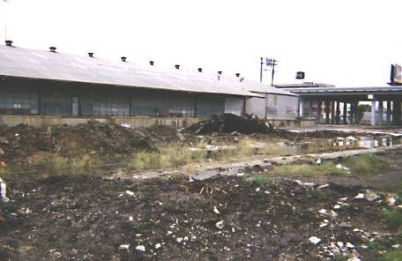
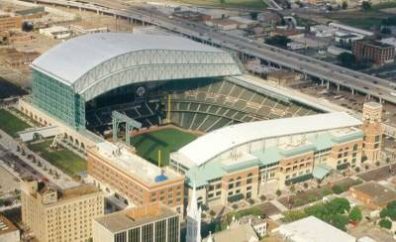
Brownfield Redevelopment
Minute Maid Park– 501 Crawford

Slide 19
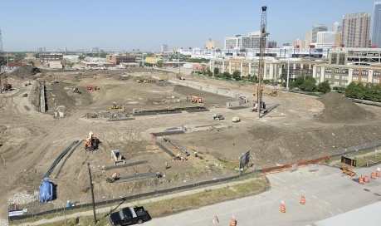
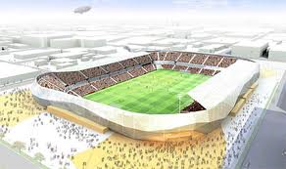
Brownfield Redevelopment
Dynamo Stadium (BBVA) – 810 Dowling

Slide 20
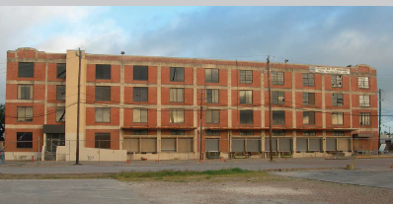
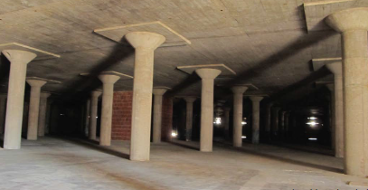
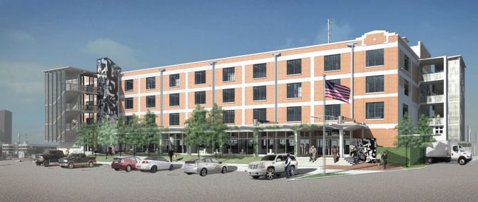
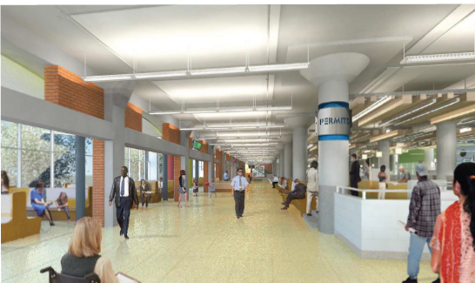
Brownfield Redevelopment
Houston Permit Center– 1002 Washington Ave.

Slide 21
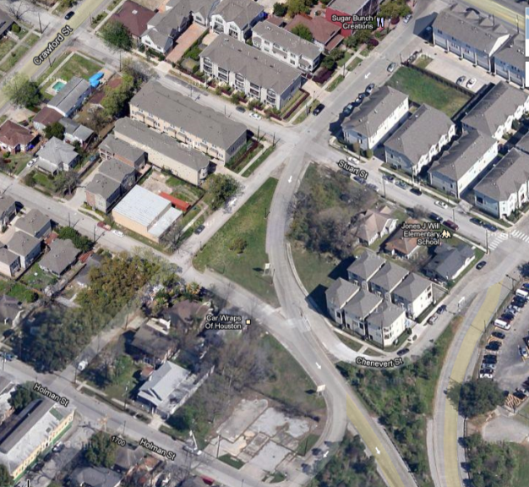
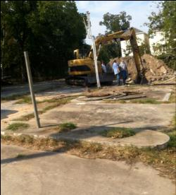
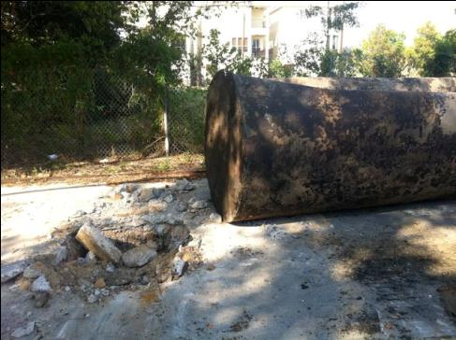
Brownfield Redevelopment
Residential Townhomes – 3400 Chenevert

Slide 22
Brownfield Redevelopment
Results Observed Over the 15 Year History
Over 60 completed redevelopment projects
More than 3000 acres restored to beneficial use,
More than $5 million tax revenue for the City
Over $800 million in investment for cleanup and redevelopment,
Over 4,000 new jobs created

Slide 23
Brownfield Redevelopment
Then Market Failure
2010 for Houston
New Approach Needed

Slide 24
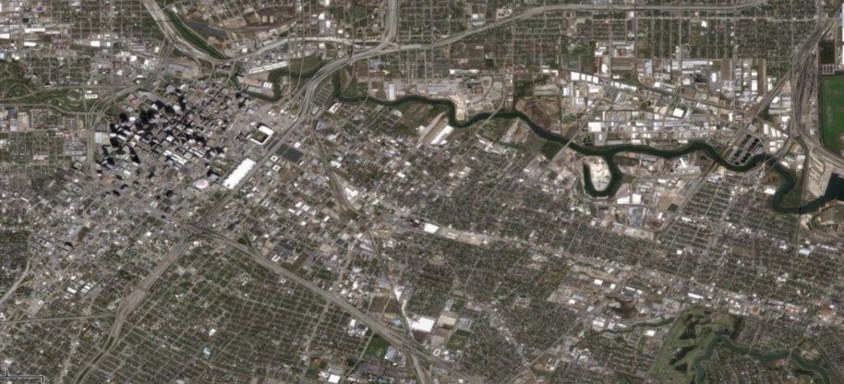
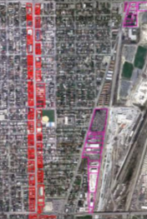
Brownfield Redevelopment
        An estimated 30% of Houston’s brownfields are located in the Harrisburg Corridor

Slide 25
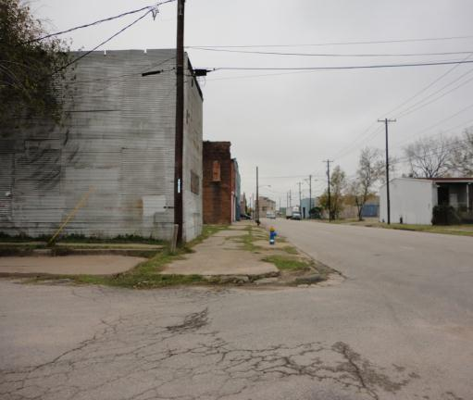
Brownfield Redevelopment
Revaluated Approach
Tax Delinquent Properties
  Low property cost
  Example
    1.5 Acres
    Tax Sale - $120,000
    Cost to Cure - $275,000
    Market Value - $85,000
    Strike Off - $15,000
    Development Incentives
    $400,000

Slide 26

Brownfield Redevelopment
Revaluated Approach
$1.5 Million Investment
Tax Positive
Job Creation
Community Need
Draw for additional investments

Slide 27

Brownfield Redevelopment
Lessons Learned
New Thinking Required
New Tools Necessary
Internal Communication
External Communication
Planning and Coordination

Slide 28
Thank You
Jedediah Greenfield
Program Manager
City of Houston
Direct: (832) 394-9005
Jedediah.Greenfield@houstontx.gov

