Slide 1
Solid and Hazardous Waste -
New Hazardous Secondary Material Rule
TAEP – August18, 2016
Heather Woodward, CHMM, REM
Technical Director
W&M Environmental Group, LLC
972-516-0300

Slide 2
Agenda
Introduction
  Refresher on the Definition of a Solid Waste (DSW)
Hazardous Secondary Material (HSM) Rule
  What is a HSM?
  Refresher on the history of the HSM Rule
  Elements of the HSM Rule
Summary
How does the HSM Rule help Generators?

Slide 3


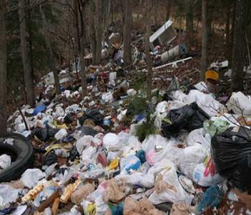
I. Introduction
Solid Waste Definition Refresher

Slide 4
SOLID WASTES
Non-Hazardous Wastes
Hazardous Wastes
Universal Wastes
Listed Wastes
Characteristic Wastes
MATERIALS
Special Wastes
Hazardous Waste Exclusions
40 CFR §261.4(b)
Household Hazardous Waste
Mining Overburden §261.4(b)(3)
Used Oil
40 CFR §279
Lead-Acid Batteries
40 CFR §266.80
Tires
Trash / Rubbish
Solid Waste Exclusions
40 CFR §261.4(a)
(i.e., scrap metal)
Certain Petroleum-contaminated media §261.4(b)(10)
Solid Waste Exclusions
40 CFR §261.2(e)
Not Subject to RCRA
Subject to RCRA

Slide 5
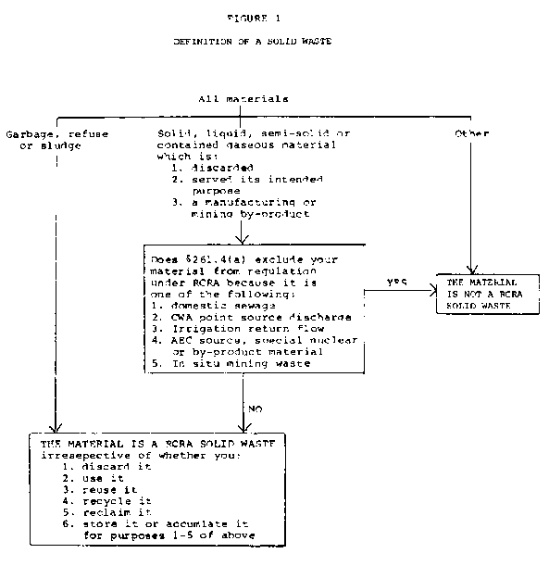
Definition of Solid Waste (DSW)
Step 1 - Solid Waste?
  Solid waste (40 CFR §261.2) any discarded material that is not excluded by §261.4(a)
  Discarded Material – any material which is abandoned, recycled, inherently waste-like, or military munition

Slide 6
Solid Waste Determination
Step 1 – Solid Waste? (con’t)
  §261.4(a) – Solid Waste Exclusions
    (1) – (22) – various exclusions including CWA discharges, closed-loop recycling, scrap metal, solvent-contaminated reusable wipes, etc.
    (23), (24), (27) – Hazardous Secondary Material (HSM) rule
  §261.2(e) Materials not solid waste when recycled by being:
    Used or reused as ingredients in an industrial process to make a product, provided the materials are not being reclaimed
    Used or reused as effective substitute for commercial products; or
    Returned to original process as a feedstock substitute
  §261.2(f) – must document that there is a known market if sold back into the market

Slide 7
  Materials ARE solid wastes if recycled when “*” in §261.2 Table 1
§261.2 Table 1 | Use constituting disposal (§261.2(c)(1)) | Energy recovery/ fuel (§261.2(c)(2)) | Reclamation (§261.2(c)(3)) | Speculative accumulation (§261.2(c)(4))
Spent Materials | * | * | * | *
Sludges (listed in 40 CFR Part §261.31 or §261.32) | * | * | * | *
Sludges exhibiting a characteristic of hazardous waste | * | * | — | *
By-products (listed in 40 CFR §261.31 or §261.32) | * | * | * | *
By-products exhibiting a characteristic of hazardous waste | * | * | — | *
Commercial chemical products listed in 40 CFR §261.33 | * | * | — | —
Scrap metal other than excluded scrap metal (see §261.1(c)(9)) | * | * | * | *
NOTE: The terms ‘‘spent materials,’’ ‘‘sludges,’’ ‘‘by-products,’’ and ‘‘scrap metal’’ and ‘‘processed scrap metal’’ are defined in §261.1.

Slide 8
II. Hazardous Secondary Material Rule

Slide 9
DSW HSM Rule
Definition of Solid Waste HSM Rule - A Brief History
2008 – EPA originally finalized 40 CFR §261.4(a)(23)-(25)
  Not adopted by most states (Texas included)
2011 – EPA Proposed changes to the DSW HSM rule – never finalized
2015 – EPA modified DSW HSM Rule
  40 CFR §261.4(a)(23), (24), removed (25) and added (27)
  Final January 15, 2015 and effective July 15, 2015
TCEQ made changes to 30 TAC §335 to adopt 2015 DSW HSM
(and other regulations not included in this presentation)
  30 TAC §335.26 adopts 40 CFR §261.4(a)(23), (24), and (27) by reference
  Effective June 16, 2016

Slide 10
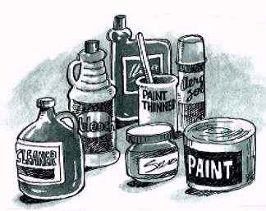
What is a HSM?
30 TAC §335.1(70) Hazardous Secondary Material - A secondary material (e.g., spent material, by-product or sludge) that, when discarded, would be identified as a “Hazardous waste”
  Listed by-products;
  Listed sludges; and
  Spent materials
  That are recycled by being reclaimed

Slide 11
  Materials ARE solid wastes if recycled when “*” in §261.2 Table 1
§261.2 Table 1 | Use constituting disposal (§261.2(c)(1)) | Energy recovery/ fuel (§261.2(c)(2)) | Reclamation (§261.2(c)(3)) | Speculative accumulation (§261.2(c)(4))
Spent Materials | * | * | * | *
Sludges (listed in 40 CFR Part §261.31 or §261.32) | * | * | * | *
Sludges exhibiting a characteristic of hazardous waste | * | * | — | *
By-products (listed in 40 CFR §261.31 or §261.32) | * | * | * | *
By-products exhibiting a characteristic of hazardous waste | * | * | — | *
Commercial chemical products listed in 40 CFR §261.33 | * | * | — | —
Scrap metal other than excluded scrap metal (see §261.1(c)(9)) | * | * | * | *
Allows these 3 * boxes to be excluded from solid waste … but there are caveats

Slide 12

HSM - the Caveats
  40 CFR §260.43 – Legitimate Recycling Provision
  40 CFR §261.4(a) – HSM Solid Waste Exclusions
  (23) Generator-controlled Exclusion
  (24) Verified Recycler Exclusion
  (25) [Reserved]
  (27) Remanufacturing Exclusion

Slide 13
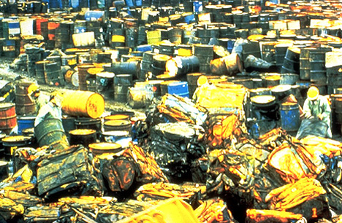
Legitimate Recycling Provision
40 CFR §260.43
Legitimate Recycling Provision – 4 Factors
  Hazardous secondary material must provide a useful contribution to the recycling process or to a product or intermediate.
  Recycling must produce a valuable product or intermediate.
  Hazardous secondary material must be managed as valuable commodities
  The product of recycling must be comparable to a legitimate product or intermediate
Just say “No” to sham recycling
Must meet all 4 Factors

Slide 14
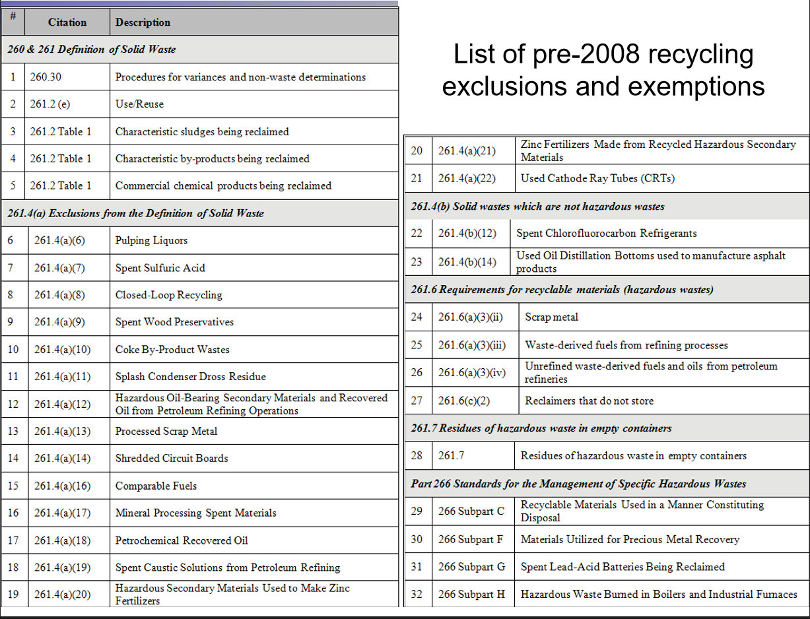
Legitimate Recycling Provision
40 CFR §260.43
Legitimate Recycling Provision – How does it affect pre-2008 recycling exclusions?
Does not revise the pre-2008 recycling exclusions
But must be “legitimate recycling”
Document!
* List from Texas Chemical Council comment letter to TCEQ dated January 29, 2016

Slide 15
Legitimate Recycling Provision
40 CFR §260.43
Legitimate Recycling Provision – How does it affect pre-2008 recycling exclusions? (cont’d)
  EPA’s Position:
    The final rule does not add notification to the pre-2008 recycling exclusions and instead recommends further study.
    The final rule does not revise the pre-2008 recycling exclusions to include an explicit legitimacy requirement. Instead, the 2015 final rule codifies the long-standing policy of prohibiting sham recycling.
  Industry Concern
    Over time the “presumption” of legitimacy for the pre-2008 exclusions will deteriorate, and legitimacy requirements will creep in.

Slide 16
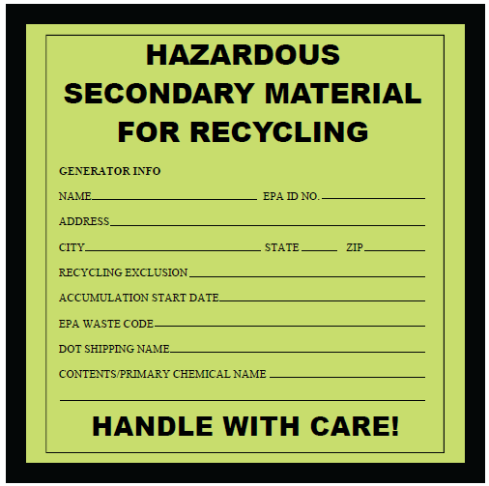
Generator-Controlled Exclusion
40 CFR §261.4(a)(23)
  Generated and legitimately reclaimed under the control of the generator
    On-Site
    Off-site facility if the reclaiming facility is controlled by the generator, and the generator provides certain certification statements
    Tolling contractor
Generator must comply with:
    HSM is “contained” – 40 CFR §260.10;
    30 TAC §335.1(33)
      Unit is in good condition and designed for HSM
      Properly labeled (or log)

Slide 17
Generator-Controlled Exclusion
40 CFR §261.4(a)(23)
  Generator must comply with:
    Not Speculatively Accumulated per 40 CFR §261.1(c)(8)
      Show that the material is potentially recyclable and has a feasible means of being recycled
      ≥ 75% recycled per year
      Properly labeled with date material placed in unit (or log)
    Notification Requirements (EPA 8700-12 Form)
    Documentation of legitimacy determination – maintained on-site
    Suggested Documentation of Legitimate Recycling Template
  Emergency preparedness and response

Slide 18
Verified Recycler Exclusion
40 CFR §261.4(a)(24)
  Verified Recycler must comply with:
    RCRA Part B Permit to reclaim HSM, or
    Obtain Variance per 40 CFR §260.31(d)
      Demonstrate reclamation/recycling legitimacy;
      Financial assurance;
      Not subject to formal enforcement within past 3 years;
      Proper equipment and trained personnel for safe management of HSM;
      Emergency preparedness and response;
      Appropriately manage/dispose generated residuals; and
      Address the potential of risk to nearby communities

Slide 19
Verified Recycler Exclusion
40 CFR §261.4(a)(24)
  Verified Recycler must comply with:
    Recordkeeping requirements
      Records of received HSM
      Provide generator with confirmations of receipt
    Appropriately handle HSM
    at least as protective as for an “analogous raw material”
    Notification Requirements (EPA 8700-12 Form)

Slide 20
Verified Recycler Exclusion
40 CFR §261.4(a)(24)
  Generator must:
    “Contain” HSM and not speculatively accumulated
    Notification Requirements (EPA 8700-12 Form)
    HSM sent to a verified recycler or RCRA Part B permitted facility
    Maintain records of all off-site shipments (transporter, reclaimer & quantity) and confirmation of receipt
    Emergency preparedness and response

Slide 21
Remanufacturing Exclusion
40 CFR §261.4(a)(27)
Encourages the recycling of 18 higher-value hazardous spent solvents
  Used for reacting, extracting, blending, or purifying chemicals in the pharmaceutical, organic chemical, plastics and resins, and the paint and coatings sectors
  Both Generator and Remanufacturer must:
    Notification Requirements (EPA 8700-12 Form)
    Jointly develop a Remanufacturing Plan
    Maintain records of shipments and confirmation of receipts
    Spent solvents - managed in RCRA equivalent tanks or containers
    Not speculatively accumulated

Slide 22



III. Summary

Slide 23
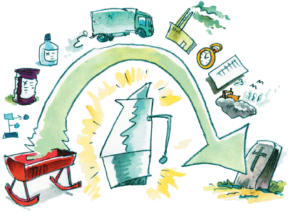
Summary
How does the HSM rule help Generators?
  Allows new avenues to recycle HSM
  If HSM is excluded as a solid waste it:
    Does not count toward generator status
    No annual reporting requirements
  Potentially reduces long-term liability
Document, document, document!!

Slide 24
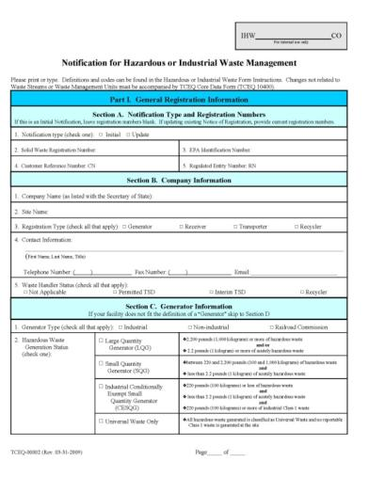
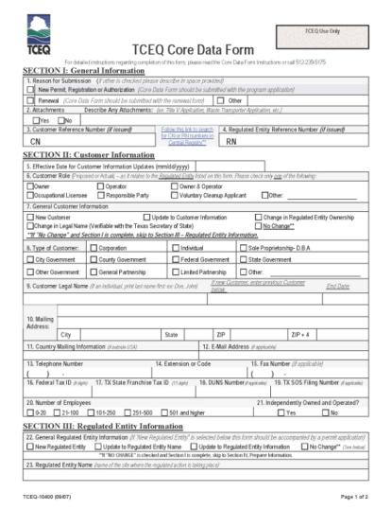
TCEQ HSM Notification of Intent
Applies to: Generators, Verified Recyclers, and Intermediate Facilities
Required Forms:
  EPA Form 8700-12
  TCEQ Core Data Form
  Waste Permits Correspondence Cover Sheet
Where:
Texas Commission on Environmental Quality
Industrial and Hazardous Waste Permits Section
MC-130
PO Box 13087
Austin, Texas 78711-3087

Slide 25
Summary
Resources
  EPA Final Rule Summary:
  https://www.epa.gov/hwgenerators/final-rule-2015-definition-solid-waste-dsw
  EPA 8700-12 Form:
  https://www.epa.gov/sites/production/files/2015-11/documents/notification_rcra_sutitle_c_activity_instructions_forms.pdf
  List of Verified Recyclers:
  https://www.epa.gov/hwgenerators/list-facilities-have-notified-they-are-managing-under-2015-definition-solid-waste-dsw
    TCEQ Final Rule allows transfer of HSM to Verified Recyclers outside Texas
  TCEQ Website: https://www.tceq.texas.gov/permitting/waste_permits/ihw_permits/ihw_exemptions.html

Slide 26
Upcoming RCRA & DOT HazMat Class
Where: Downtown Club in Houston
When: September 28 & 29th
Register: https://www.wh-m.com/events/
Hackberry Creek Country Club in Dallas
September 14 & 15th
RCRA 8-Hour Course Topics
Waste identification and classification
Generator requirements
Waste container handling, management and storage requirements
Manifests and recordkeeping requirements
Pollution prevention ideas
DOT HazMat 4-Hour Course
  Function-Specific training to complete a hazardous waste manifest
  DOT Hazard Classification
  Proper shipping name and shipping papers
  Labeling, marking and packaging requirements
  Placarding and loading

Slide 27
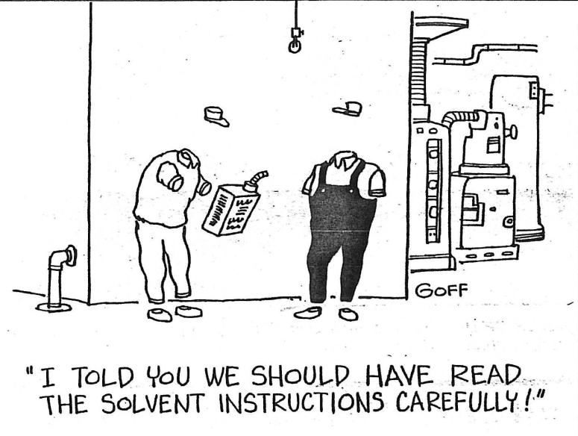
Questions??

Slide 28
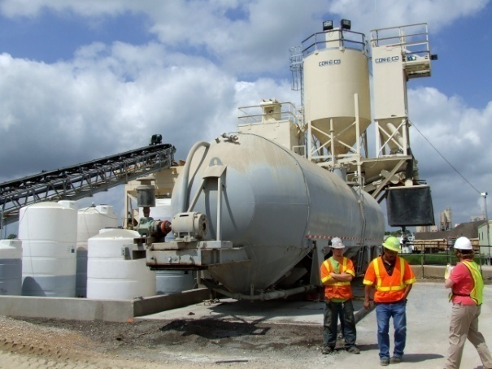

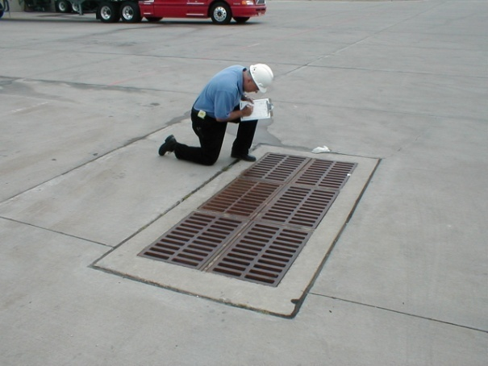
Contact Information
Heather Woodward, CHMM, REM
Technical Director
W&M Environmental Group, LLC
972-516-0300
hwoodward@wh-m.com

